Slide 1

Substation and Distribution Automation
Module 9: Automated Switching and Reconfiguration

Slide 2
Module 9 Overview
Part 1: Switching and protective devices
Part 2: Protection schemes
Part 3: Reconfiguration
Part 4: Switching examples

Slide 3
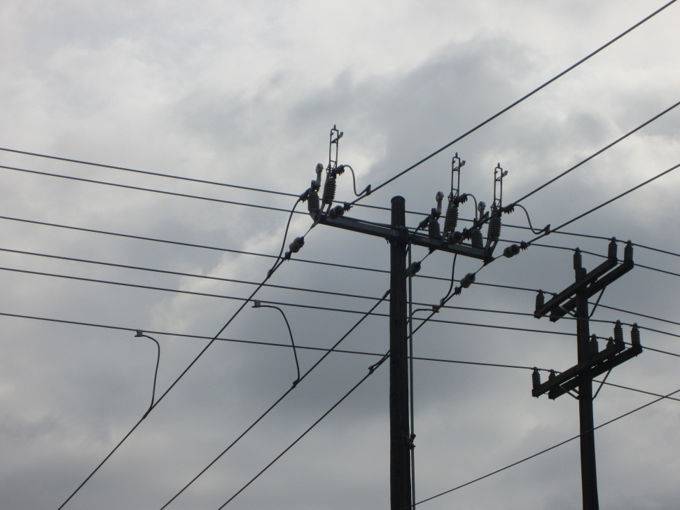
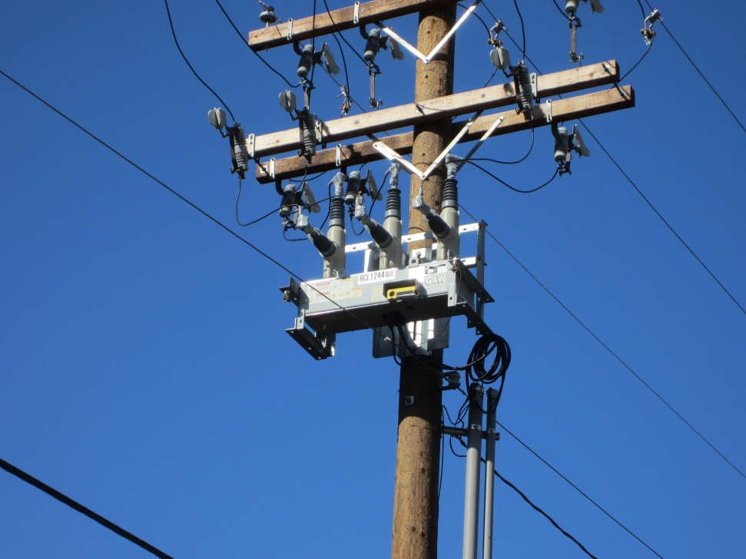
Part 1: Switching and Protective Devices

Slide 4
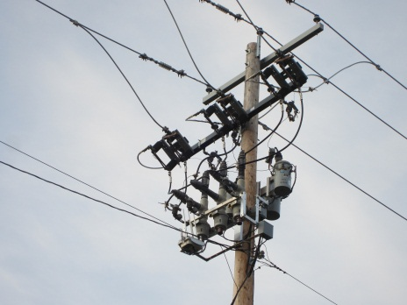
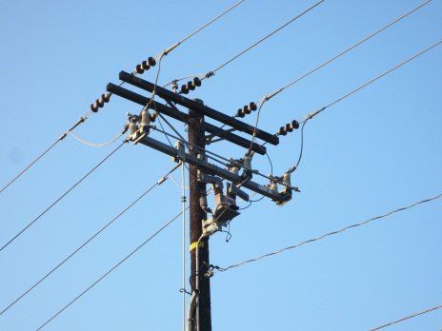
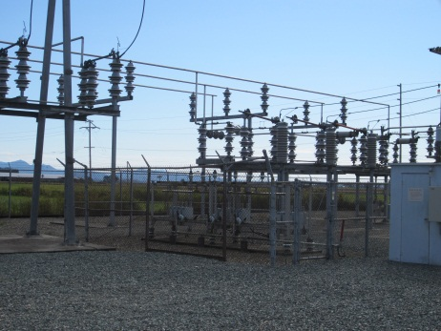
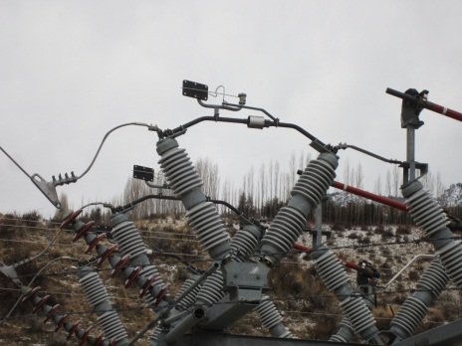
Switching and Protective Devices
Switching devices:
Manual switches
Remote controlled switches
Protective devices:
Circuit Breakers
Fuses
Overcurrent Relays
Reclosers
Sectionalizers

Slide 5
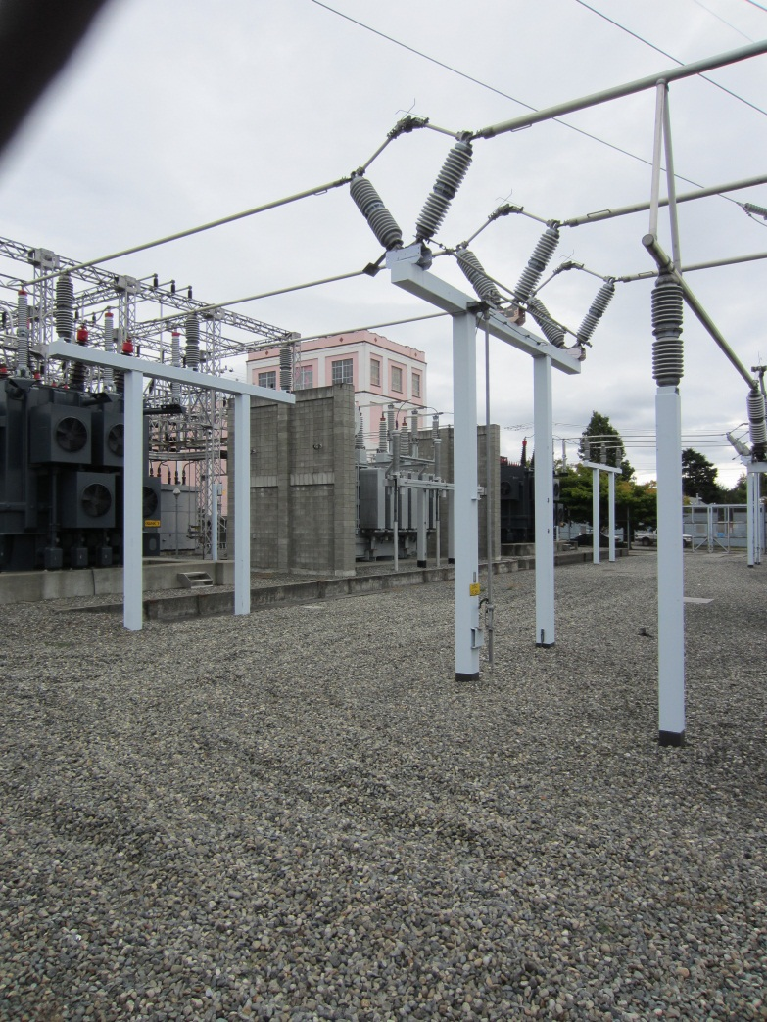
Manual Switches: Substation
Manual switches in a substation are simple devices that typically do not have any controls or communication.
They are manually operated, usually by an operating device at the bottom of the support structure.
Switches are not designed to interrupt a fault current.
Because of the lack of synchronizing equipment or the proper contacts, paralleling cannot be accomplished across a switch.
At the substation level they are used to isolate equipment for maintenance or to reconfigure bus work.

Slide 6
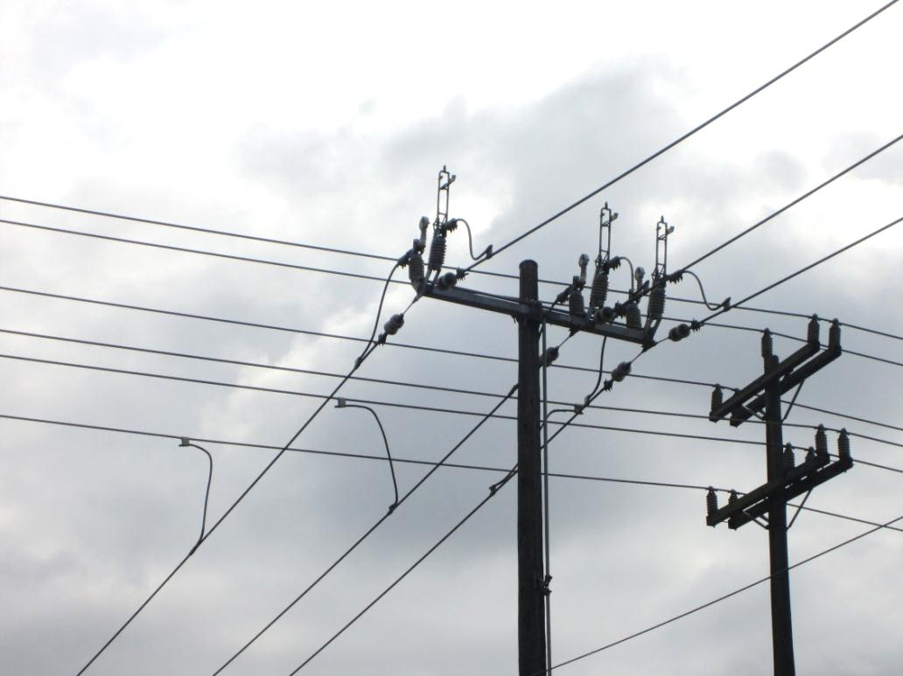
Manual Switches: Distribution Feeder
Manual switches on a distribution feeder are simple devices that typically do not have any controls or communication.
They are manually operated, usually by an operating device at the bottom of the utility pole.
Switches are not designed to interrupt a fault current.
Because of the lack of synchronizing equipment or the proper contacts, paralleling cannot be accomplished across a switch.
At the feeder level manual switches are used to change the topology of the feeder.

Slide 7
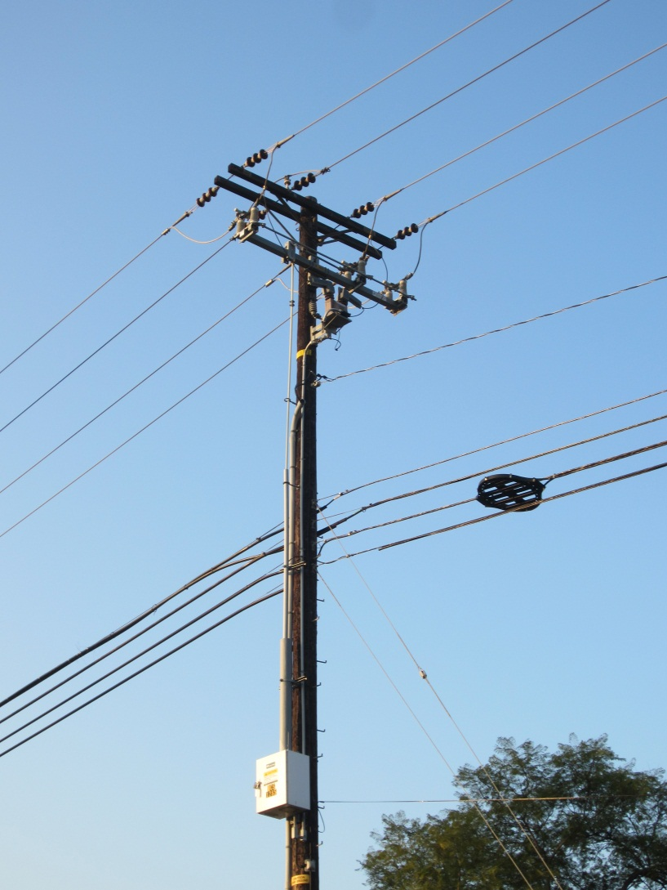
Remote Control Switches
Remote control switches can be located in a substation or on a distribution feeder.
Remote control switches have the same electrical capabilities as locally operated switches.
The difference is that the end of the operating mechanism is connected to a motor instead of a handle for manual operations.
The operation is controlled via signals transmitted using the SCADA system.
These switches still cannot be used for paralleling, but they can be operated from a remote location or tied into an automation scheme.
When used for reconfiguration schemes, remote controlled switches must have their own internal batteries.

Slide 8
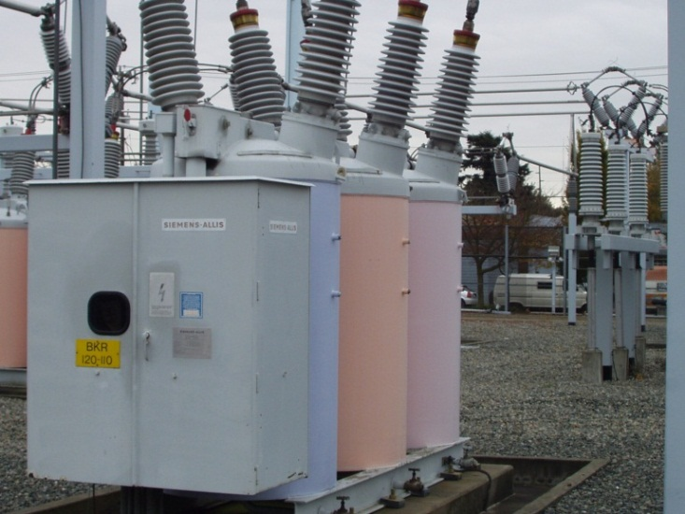
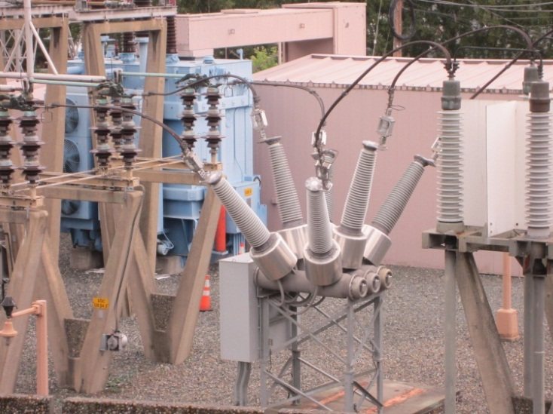
Circuit Breakers
Circuit breakers are similar to switches, but have the ability to break fault current.
They are generally located at a substation because of their size, but can be located on a feeder, and have the ability to be operated remotely.
After an over current condition, a circuit breaker can be reclosed.
Because of their ability to interrupt current, they are typically used for protection rather than as a simple disconnect.
The operating signal for a circuit breaker must come from a relay type device or remote signal.
Breakers can be classified based on the medium used to quench the arc:
Air
Oil
Vacuum
SF6

Slide 9
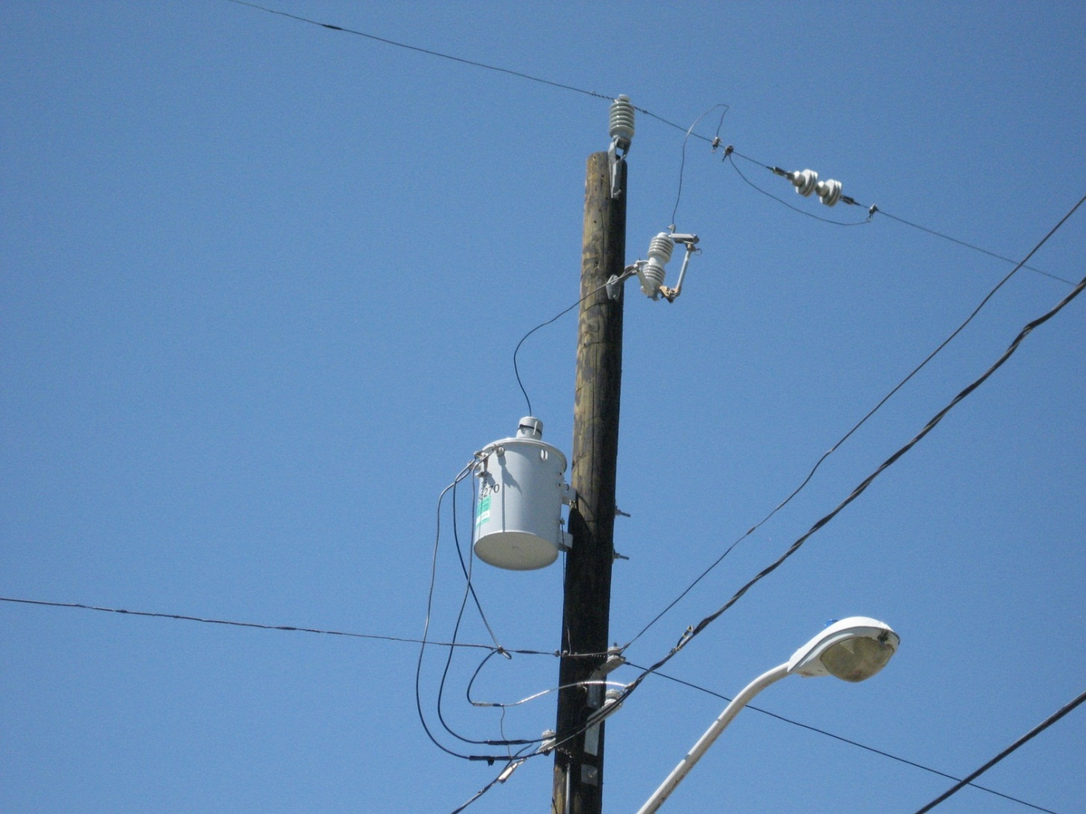
Fuses
Overcurrent fuses are a low cost protection device used to interrupt fault current.
These are thermal devices that operate on an inverse time curve. The higher the fault current the quicker the fuse will blow.
Once a fuse interrupts an overcurrent condition, it need to be manually replaced by a line crew.
Fuse coordination is the practice of coordinating the sizes of fuses so that the fuse closest to the fault will blow first.
Proper fuse coordination requires knowledge of the system load and is complicated by the presence of distributed resources.

Slide 10
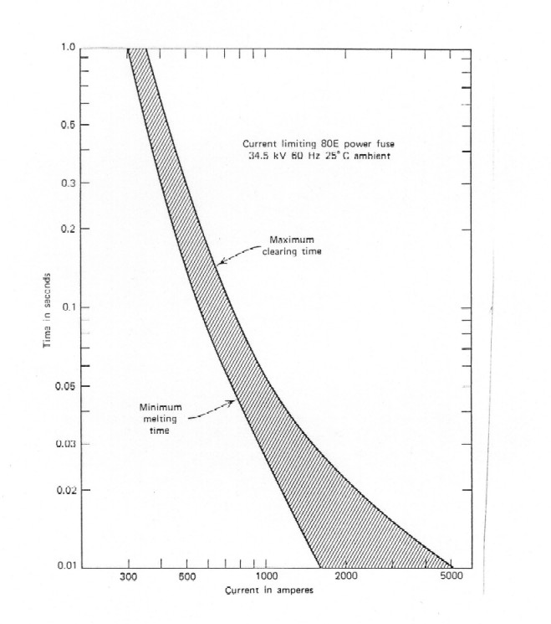
Fuses Cont.
There are two primary types of fuses:
Current limiting
Expulsion
Current limiting fuses are the most common and they reduce the magnitude and duration of the fault current by introducing a high resistance into the circuit. This is the traditional fusible link.
Expulsion fuses use gas generation and exhaust to remove conducting particles from the arc column and allow the fuse to interrupt current at current zero. Expulsion fuses are not current limiting devices, but they will limit the duration of the fault.
IEEE Guide for Protective Relay Applications to Distribution Lines, IEEE Std C37.230-2007

Slide 11
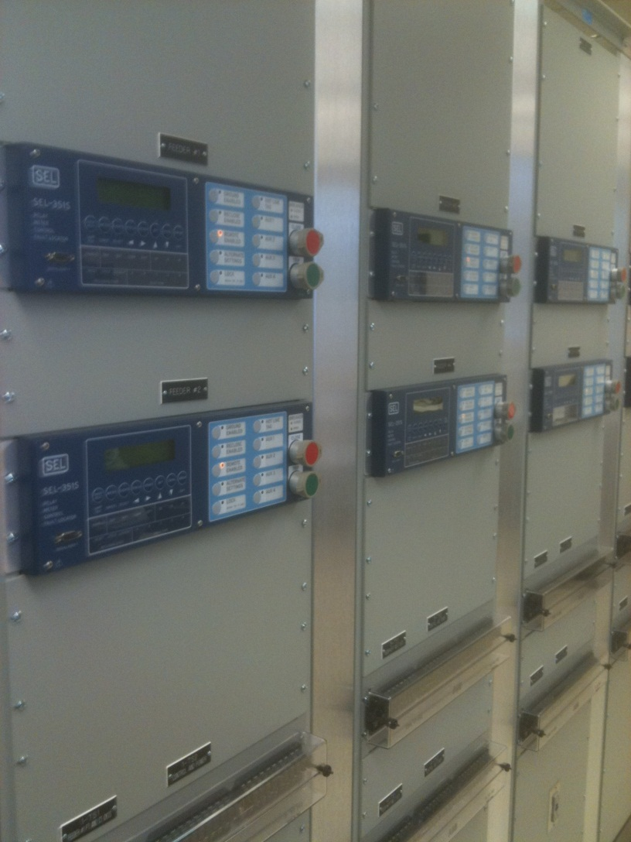
Protection Relays
While fuses isolate a fault by opening a fusible link, protection relays take local measurements and generate control signals for circuit breakers.
In contrast to a fuse which can only measure current, protection relays can measure current and voltage wave forms and generate a number of values based on these.
Real power
Reactive power
Sequential components
Phasor measurements
Digital relays can be GPS synchronized and connected to the substation LAN. This allows for comprehensive protection schemes.
Protection relays can be accessed remotely for maintenance as well as updates.

Slide 12
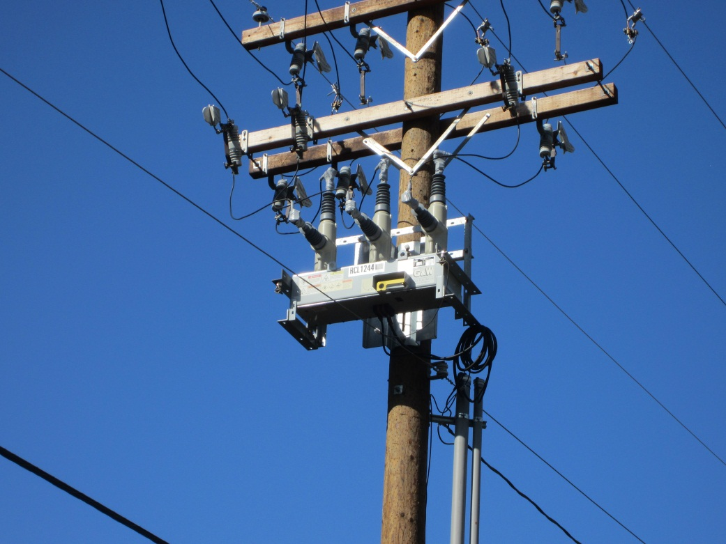
Reclosers
Similar to circuit breakers, but with more complex controls and the option for even more measurement and feedback.
Reclosers can be single or multiple phases.
Designed to minimize the number of customers affected by momentary faults.
Trips and recloses to clear temporary faults
When a fault occurs the recloser will interrupt the fault current and remain open for a time period to allow momentary faults to clear.
Then the recloser with close back into the fault and see if it has cleared.
If the fault has cleared then the recloser will stay closed, but if there is still a fault then the recloser will reopen.
The number of tries to reconnect, or shots, is user configurable, but is commonly set for three attempts.
After the final shot a recloser will lock open at which point a utility crew must locally reset the unit.

Slide 13
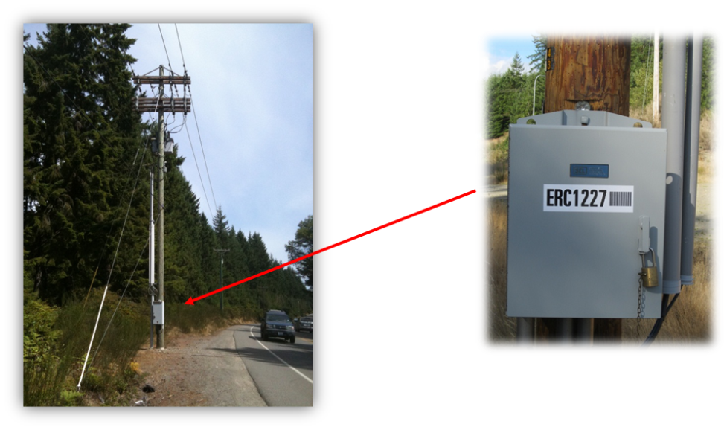
Reclosers Cont.
Reclosers can significantly increase the reliability of a power system that experience numerous momentary faults.
For a permanent fault, reclosers are of little to no benefit unless operated in coordination with sectionalizers.
The tripping signal can be generated with a hydraulic system or and electronic signal.
The arc can be quenched with oil, vacuum, or SF6.
The contacts for breaking the fault current will reside at the top of the utility pole while the control box will be at the bottom.
Modes of operation:
single-phase trip
single-phase lockout
single-phase trip three-phase lockout
three-phase trip three-phase lockout

Slide 14
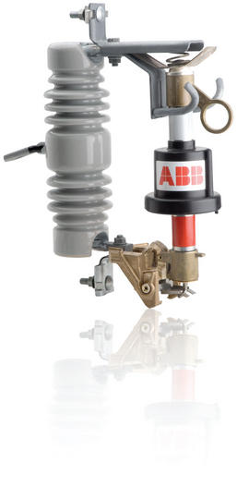
Sectionalizers
Similar to switches, except that they operate based on local measurements and must be properly coordinated with reclosers.
Used in conjunction with a recloser.
The recloser breaks the fault current
While under a no-load condition he sectionalizer disconnects the faulted section from the feeder
The recloser then reconnects the rest of the feeder to power.
Sectionalizers coordinated with reclosers are ideal for system with a combination of permanent and momentary faults.
With the development of the Smart Grid, sectionalizers are starting to incorporate more advanced metering and reporting capabilities.

Slide 15
Part 2: Protection Schemes
An individual protective device can accomplish a single task.
By using combinations of the individual protective devices discussed in Part 1 it is possible to form a complete protection scheme.
The protection schemes will vary depending where they are in the power system.
Generation: large single devices that are critical for operations.
Transmission: transmission lines and transformers.
Distribution: transformers and distribution feeders.
Part 2 will examine protection schemes from the perspective of what is necessary to implement them.

Slide 16
Protection Schemes to be Examined
Generator protection: a collection of schemes that protect the generator from abnormal operations such as loss of excitation, reverse power, and overload.
Transformer protection: a scheme designed to protect an individual transformer from events such as mechanical faults, overvoltage, and overload.
Bus protection: a set of protection schemes designed to protect bus work from electrical faults.
Line protection: various schemes designed to protect transmissions and distribution lines from thermal overload.
Special Protection Systems (SPS): complicated systems designed to address wide area problems.

Slide 17
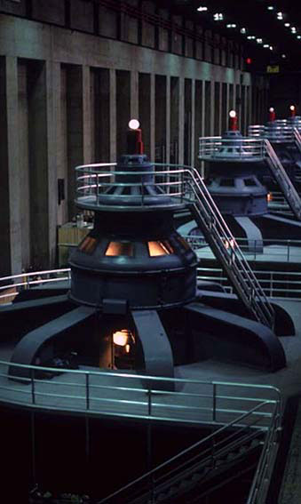
Generator Protection
Generators are large central pieces of equipment that must be protected.
Types of generator protection:
Stator phase fault
Phase fault
Stator ground fault
Field ground
Loss of excitation
Overcurrent/overload
Since generators are single units protection operations do not require a communications channel that leaves the generator house. A communications channel for normal operations may be necessary.
There may be a need for coordinated protection between multiple generators and a common transformer.
Switching for the purposes of protection will remove the generator from operation.

Slide 18
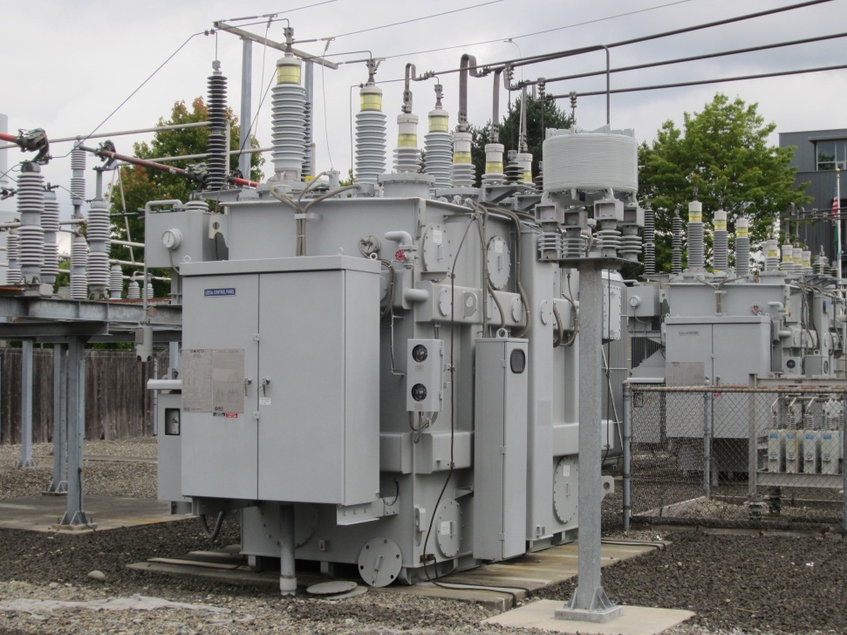
Transformer Protection
Transformers can be large central pieces of equipment or smaller units on lower voltage systems.
Types of transformer protection:
Phase fault
Ground fault
Thermal protection
Mechanical fault
Overcurrent/overload
Since transformers are single units protection operations do not require a communications channel that leaves the substation.
Switching for the purposes of protection will remove the transformer from operation.
Switching can be performed to reduce the load on a transformer, but this is not an automated protection process.

Slide 19
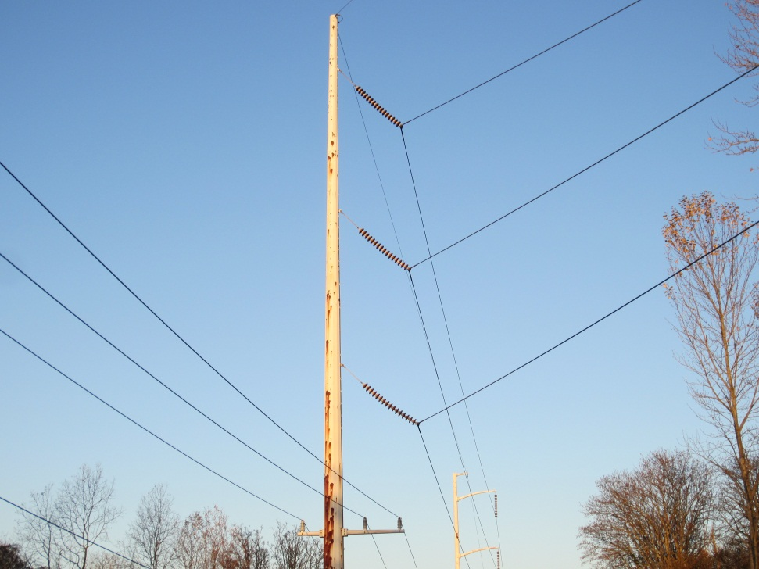
Line Protection
Lines are connected between two points.
Transmission: connected between two substations
Distribution: contacted to a single substation
Protection systems for a single line are generally designed to protect the line from thermal overload or fault.
At the transmission level line protection sometimes require communications between the two points.
At the distribution level line protection rarely needs a communications line.
Switching for the purposes of protection will remove the line from operation.

Slide 20
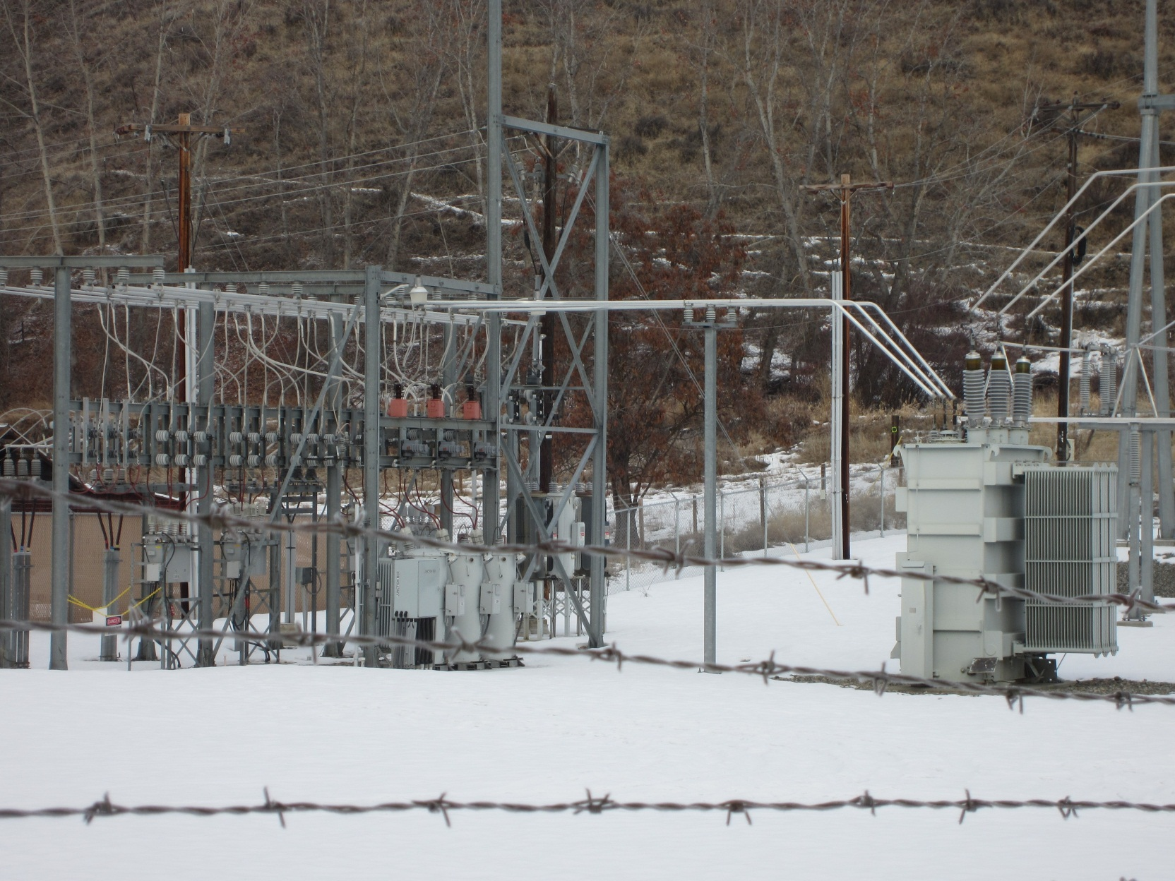
Bus Protection
Electrical busses are simply metal bars that are used to connect different pieces of equipment.
Bus protection is used within a substation to protect electrical buses.
Bus protection is generally designed to protect a single bus or sub-bus from phase to phase or phase to ground faults.
Switching for the purposes of protection will remove the bus from operation.

Slide 21
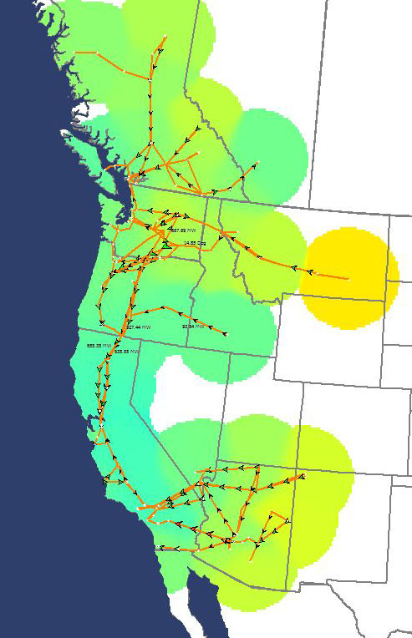
Special Protection Scheme (SPS)
At the transmission system there are some dynamic issues that span an entire region or interconnect.
To address these issues special protection schemes, also known as remedial action schemes (RAS), were developed.
A special protection system requires a communication system because of the wide geographic separation of its components.
Switching operations for a SPS have the potential to affect multiple substations including generation units.

Slide 22
Part 3: Reconfiguration
Reconfiguration changes the topology of the distribution system to achieve one of a number of objectives.
Transfer load between feeders after a fault as part of a restoration scheme.
Minimize losses by balancing the load on adjacent feeders.
Improve voltage profile by balancing load on adjacent feeders.
Reconfiguration generally occurs between two or more distribution feeders where load transfers, or load restoration, is involved.
Reconfiguration can be a manual or automated process.
Manual: this is the most common and requires line crews to manually change the position of switches in coordination with the system operator.
Automated: less common but more capable. The system will automatically reposition switches and other equipment in order to achieve a pre-defined goal.

Slide 23
Radial Reconfiguration Problem
Switches are opened and closed to reconfigure the circuit, maintaining radial configuration during normal operations.
Manual:
Switches are used that require manual operation at local locations.
Since these are switches they can only be closed into a dead circuit, it is not safe to parallel across a switch.
For this reason, manual reconfiguration is generally part of a restoration action or a well planned load transfer.
Automatic:
Switches and circuit breakers are used.
By using a combination of switches and breakers it is possible to reconfigure the system under load.
In an automatic system it is possible to dynamically reconfigure the system during normal operations without causing a loss of load.
The repositioning of a number of switches in a system in order to achieve a goal is an optimization problem.
Optimization problem: Find “spanning tree” that minimizes an objective function, while satisfying voltage constraints, capacity constraints, and reliability constraints

Slide 24
Solution Methods for the Reconfiguration Problem
Determining the proper sequence of switch operations is a combinatorial nonlinear problem.
There are a number of potential solution methodologies for determining the optimal switching sequence:
Heuristic solutions:
Branch exchanges
Fuzzy multi-objective approach incorporating heuristic rules
Evolutionary algorithms:
genetic algorithms
simulated annealing
Variable scaling hybrid differential evolution
Switches modeled as adjustable current sources: iterative process where switch with lowest adjusted current is open until radial configuration is achieved

Slide 25
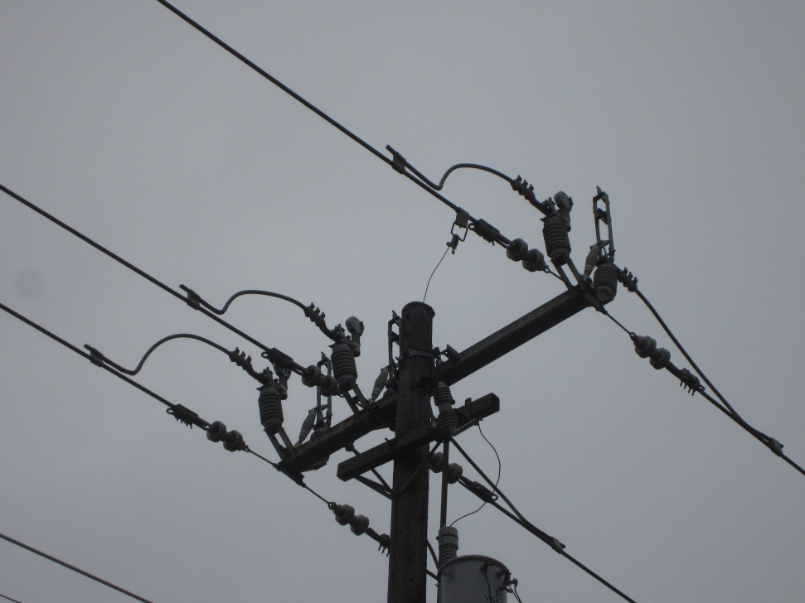
Part 4: Switching Examples

Slide 26
Overview of Switching Examples
Protection switching examples:
Example 1: Operation of a fuse to isolate a fault.
Example 2: Operation of a recloser to isolate a fault.
Example 3: Coordinated operation of a recloser and sectionalizer to isolate a fault.
Operational switching example:
Example 4: Reconfiguration of two feeders following a fault that transfers load between two feeders.

Slide 27
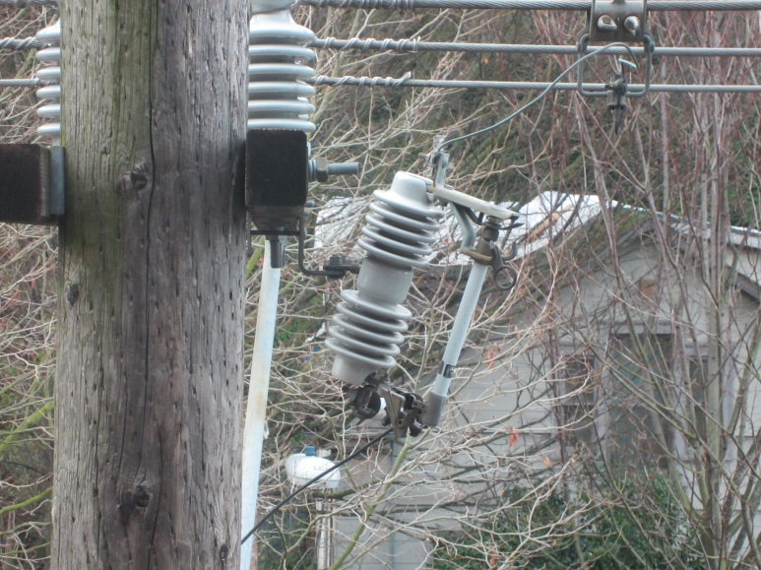
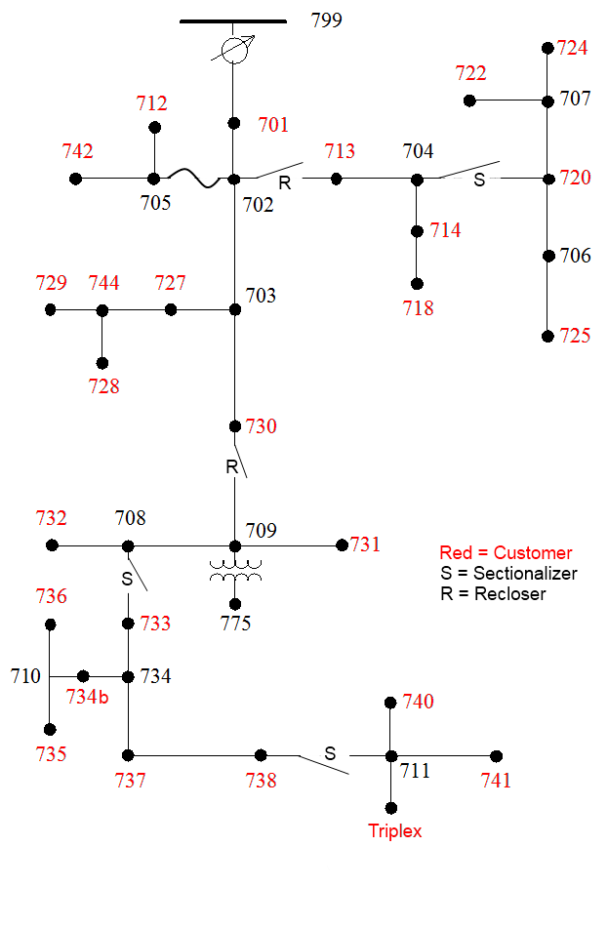

Test System for Examples 1-3
For the purposes of examples 1-3 a modified version of the IEEE 37 node test system will be used.
Since we are examining only the switching sequence we are not concerned about the voltage regulation devices or the end use loads.
The modified system will include a number of protective devices:
2 reclosers
3 sectionalizers
1 fuse

Slide 28
Example 1: Fuse Protection
In the first example we will examine the isolation of a single line to ground fault on a single phase lateral.
A single line to ground fault occurs on the line between node 705 and 712.
The fault will be isolated by a fuse on the line between node 702 and 705.
The isolation of a fault on a single phase lateral is the most basic switching/protection operation.
While the isolation of the fault is automatic based on the time curves and fault current, restoration requires a truck roll and for the crew to clear the fault and replace the fuse.

Slide 29
Example 1: Time Line
Occurrence of the permanent line to ground fault on line between 705 and 712.
Overcurrent condition causes the fuse to blow, isolating the single phase lateral.
Customers at node 712 and 742 call in to report a power outage.
The utility dispatches a line crew to investigate.
Line crew locates the fault and repairs the condition.
The line crew replaces the blown fuse with a new one, thereby restoring single phase lateral to service.
The fuse must be replaced with a properly rated fuse.

Slide 30
Example 2: Recloser Protection
In the second example we will examine the isolation of a permanent three phase fault.
The three phase fault will occur between the output of the transformer and node 775.
The fault will be isolated by the only recloser in the system.
The operation of the recloser is more complicated than a fuse because of the ability to reclose into a fault.
While reclosers can clear temporary faults without the need for a line crew to be dispatched, for permanent faults a truck roll is still required to fix the fault and reset and reclose the recloser.

Slide 31
Example 2: Time Line
Occurrence of the permanent line to ground fault between the output of the transformer and node 775.
Overcurrent condition causes the recloser between 730 and 709 to open.
Recloser waits for a time period and then closes back in, but the fault is still present.
The recloser attempts to clear the fault 2 more times and on the third try locks open.
Customers at all nodes downstream of the recloser will call in to report a power outage.
The utility dispatches a line crew to investigate.
Line crew locates the fault and repairs the condition.
The line crew then resets and recloses the recloser resorting power to the loads downstream.

Slide 32
Example 3: Sectionalizer Protection
In the third example we will examine the isolation of a permanent three phase fault with a coordinated set of reclosers and sectionalizers.
The three phase fault will occur between nodes 710 and 735.
The faulted section will be protected by the recloser and a sectionalizer, and the sectionalizer will isolate the fault.
Since there is a recloser and a sectionalizer between the source and the fault, the two devices will together to isolate the fault.
While reclosers can clear temporary faults without the need for a line crew to be dispatched, for permanent faults a truck roll is still required to fix the fault and reset and reclose the sectionalizer.

Slide 33
Example 3: Time Line
Occurrence of the permanent line to ground fault between nodes 710 and 735.
Overcurrent condition causes the recloser between 730 and 709 to open.
The sectionalizer between nodes 708 and 733 measure an overcurrent condition and prepares to open when the upstream recloser opens.
The sectionalizer between nodes 738 and 711 does not measure an overcurrent condition so it takes no action.
The recloser waits for a time period and then closes back in. This processes will be repeated once or twice to ensure that if the fault is temporary it has a change to clear.
During the operation before recloser lockout the sectionalizer between nodes 708 and 733 will open.
The recloser then closes back in and sees that there is no fault current, so it remains closed.
Customers at all nodes downstream of the open sectionalizer will call in to report a power outage.
The utility dispatches a line crew to investigate.
Line crew locates the fault and repairs the condition.
The line crew then resets and reclose the sectionalizer returning the lateral into service.

Slide 34
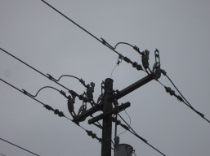
Test System for Example 4
For the purposes of example 4 we will use the two feeder test system shown to the right.
There are a number of switches in the system that allow for topological changes.
Since we are examining only the switching sequence we are not concerned about the voltage regulation devices or the end use loads.
For an actual two feeder system voltage drop would be a significant issue that must be addressed.

Slide 35
Example 4: Reconfiguration and Load Transfer
A permanent fault occurs on feeder 1 at the indicated point, which cannot be repaired in a short time period. We will assume that this is an underground cable that will take 2 days to repair.
Since 2 days is an excessive amount of time for customers to go without power, another option must be sought.
One option is for the utility to shift the affected load from feeder 1 to feeder 2 in order to restore the load.
Because of the transfer switches between the feeders. This is a viable option.
Even with the switches available, feeder 2 must have the capacity to supply the additional load.
Additionally, checks must be done to ensure that the additional load will not cause a low voltage condition since the effective length of feeder 2 has increased.
For these types of load transfer schemes to work the system must be designed to handle the changes in powerflow, this includes voltage drop, and protection settings to name a few.
For this example we will assume that all conditions are met to safely transfer load.

Slide 36
Example 4: Time Line
A permanent fault occurs on the system at the indicated point.
The fault is isolated by a protective element in the system resulting in an open breaker.
Customers at all nodes downstream of the open protection device will call in to report a power outage.
The utility dispatches a line crew to investigate.
Line crew locates the fault and determine that repairs will take a significant period of time.
As a result the decision is made to reconfigure and transfer load to feeder 2.

Slide 37
Example 4: Time Line Cont.
The first step in transferring the load is to isolate the fault from the section that is to transferred.
This is done by opening the manually operated switch as shown.
The next step is to close the isolated section of feeder 1 into feeder 2 to restore power to that section.
Once the transfer switch is closed then power is resorted to the majority of customers on feeder 1.
Once the repairs are complete the remaining load can be supplied from either feeder.

Slide 38
Module 9 Concluding Comments
Topological changes on a power system can be accomplished through the operation of switch and protective devices.
Switching devices are operated as part of planned operations.
Manual switch
Remote controlled switch
Protective devices are operated as part of a fault condition on the system.
Circuit Breakers
Fuses
Overcurrent Relays
Reclosers
Sectionalizers
Individual protective devices are combined to form protection schemes for various pieces of critical equipment.
During a fault condition, a systems topology is changed via the operation of protective devices.
Post fault, the systems topology may be further changed via a restoration procedure to reduce the impact on the en-use customers.

Slide 39
Substation and Distribution Automation
Conclusion of Module 9: Automated Switching and Reconfiguration

